Slide 1

Vel Tech Rangarajan Dr. Sagunthala R&D Institute of Science and Technology
School of Computing
Department of Computer Science and Engineering
10211CS224 / FULL STACK APPLICATION DEVELOPMENT (JAVA)
PROJECT REVIEW : MILESTONE PROJECT – 3
Date: 06-05-2026
Smart Campus Event Management System
SDG 4 – Quality Education
Presented By:
V.Vaishnavi– VTU26447– 23UECS0604
Courses Handling Faculty:
Dr.S.HEMAMLINI,M.E.,PH.D.,

Slide 2
INTRODUCTION
1
The Smart Campus Event Platform is a web-based application designed to simplify and
automate event management in educational institutions. Traditional event management methods rely on manual processes such as paper-based registration, attendance marking, and certificate distribution, which are time-consuming and prone to errors.This platform provides a centralized system where administrators can efficiently create, update, and manage events, while students can easily explore and register for them. It includes essential features such as secure user authentication, event discovery, digital attendance tracking, automated certificate generation, and real-time notifications.The system is developed using modern technologies like React.js for the frontend and PHP with MySQL for the backend, ensuring smooth performance and secure data handling.Overall, the platform improves efficiency, reduces manual workload, and ensures a better user experience, making it a reliable solution for managing campus events effectively.
2
3
4
5
6
7
8
9

Slide 3
PROBLEM STATEMENT
In many campuses, event management is still handled manually or through multiple unorganized platforms, leading to poor communication and missed updates. Organizers face difficulties in managing event details and tracking participant registrations efficiently, while students often lack a centralized system to discover and register for events. These manual processes increase the chances of errors, data mismanagement, and reduced participation. There is also no proper mechanism to monitor event engagement and performance. Therefore, there is a need for a simple, reliable, and automated system that centralizes all event-related activities. The proposed Smart Campus Event Management System aims to address these issues by improving efficiency, accuracy, and accessibility.
1
2
3
4
5
6
7
8
9

Slide 4
OBJECTIVE(S)
To design and develop a Smart Campus Event Management System: To create a centralized platform for managing campus events. To design a user-friendly interface for easy event access and management.
To implement an automated event management process: To enable event creation, registration, and tracking digitally. To ensure real-time updates and notifications for users.
To improve system efficiency: To streamline communication between organizers and participants. To reduce manual work and data management errors.
To evaluate performance of the system: To measure system reliability during multiple event operations. To analyze user experience and overall system effectiveness.
1
2
3
4
5
6
7
8
9

Slide 5
PROPOSED SYSTEM
1
The proposed solution is a web-based Smart Campus Event Management System that centralizes all event-related activities on a single platform. It allows organizers to create, update, and manage events digitally, while students can easily browse, register, and receive notifications about upcoming events. This system eliminates manual processes, reducing errors and improving data management. It effectively addresses issues such as poor communication, missed updates, and lack of coordination. Real-time notifications enhance interaction between organizers and participants. Compared to existing systems, it offers better automation, improved accuracy, and faster access to information. Overall, it increases efficiency, saves time, and provides a better user experience.
2
3
4
5
6
7
8
9

Slide 6
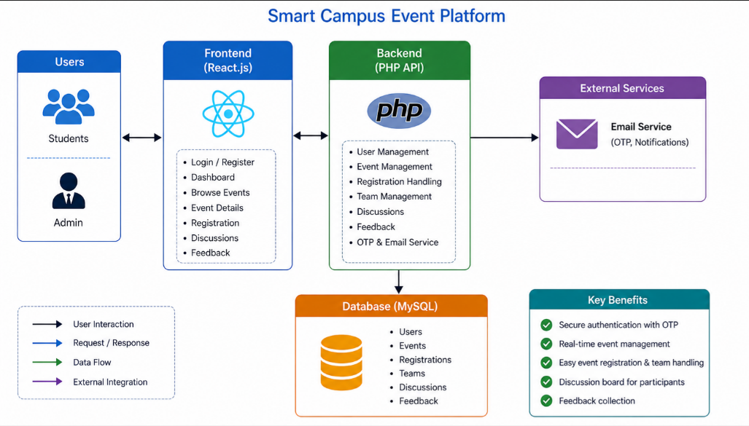
PROPOSED SYSTEM ARCHITECTURE
1
2
3
4
5
6
7
8
9

Slide 7
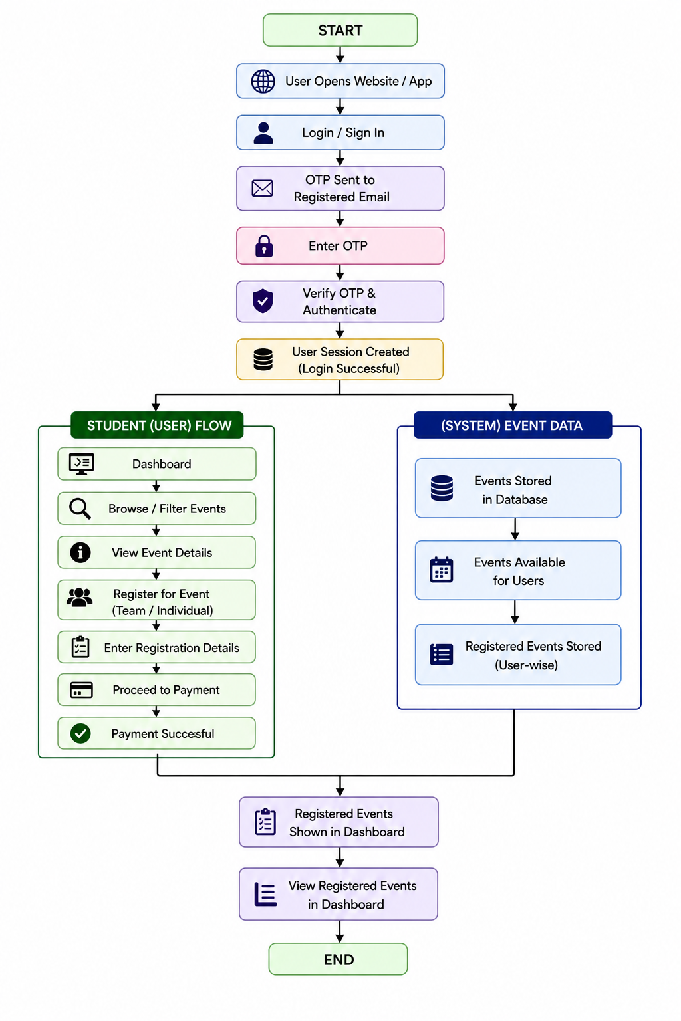
WORKFLOW
1
2
3
4
5
6
7
8
9

Slide 8
TECHNOLOGIES USED
1
1. Frontend: React.js with Vite for a fast, responsive user interface.
2. Backend: PHP for the server-side API logic and data processing.
3. Database: MySQL with PHP PDO for secure, structured data storage.
4. Languages: JavaScript (frontend), PHP (backend), SQL (data), CSS3, and HTML5.
5. Tools: XAMPP (Apache/MySQL), Node.js, and Axios for API communication.
6.API TOOLS: Sendgrid.
2
3
4
5
6
7
8
9

Slide 9
MODULE DESCRIPTION
1
1. Authentication & Security Module This module handles user registration and login. It ensures secure access using password encryption and OTP verification. It also manages user roles such as admin and student.
2. Event Management Module This module allows administrators to create, update, and manage events. It includes adding event details, scheduling, and controlling participant limits.
3. Event Discovery & Registration Module This module enables users to browse available events and register for them. Users can view event details and choose individual or team participation.
4. Attendance & Certification Module This module tracks participant attendance and automatically generates certificates. It also sends notifications and updates to users.
2
3
4
5
6
7
8
9

Slide 10
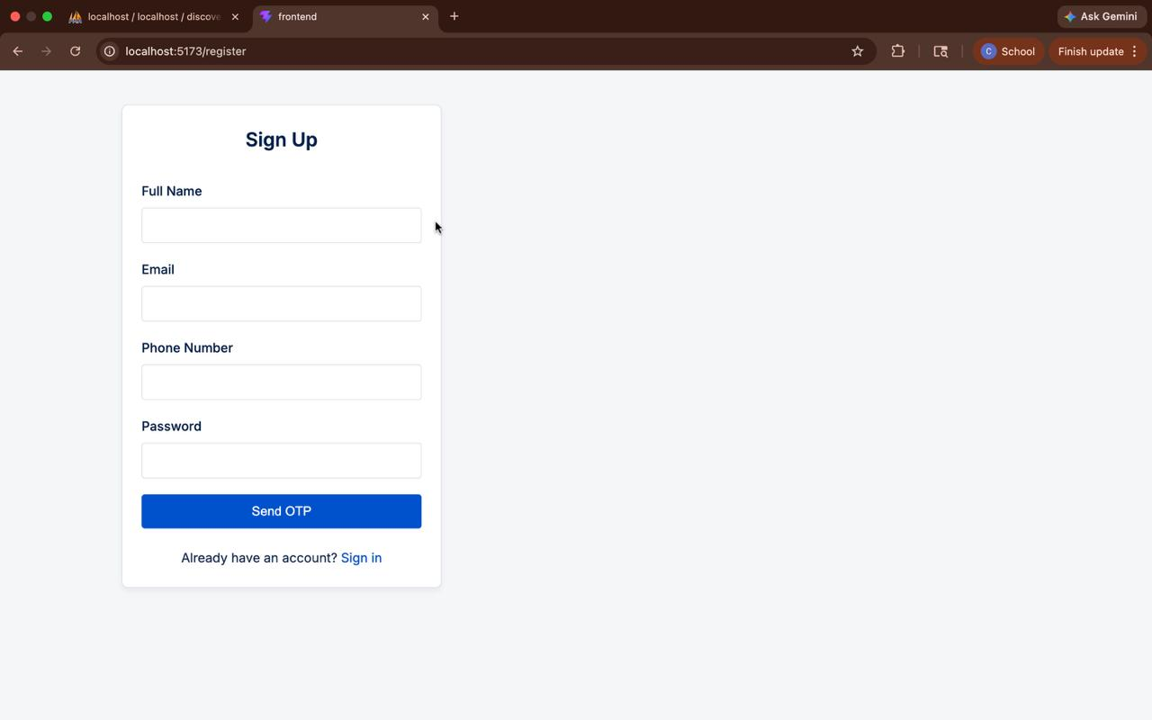
IMPLEMENTATION SCREENSHOTS
1
2
3
4
5
6
7
8
The Sign Up process allows users to create an account by entering details like name, email, phone number, and password an OTP is sent to verify the user’s identity and ensure security,after successful verification, the account is created and stored in the database. Users can then log in and access the platform features.
9

Slide 11
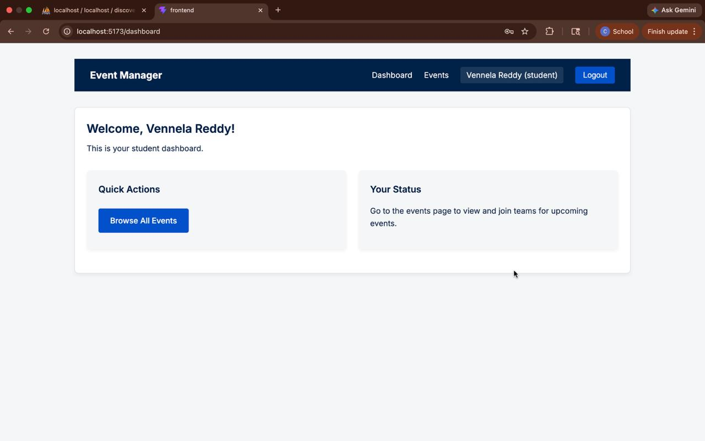
IMPLEMENTATION SCREENSHOTS
The Student Dashboard provides a personalized view after successful login. It displays a welcome message and allows users to access available events. Students can view, register, and track their participation in events. The dashboard is simple, organized, and user-friendly for easy navigation.
1
2
3
4
5
6
7
8(A)
9

Slide 12
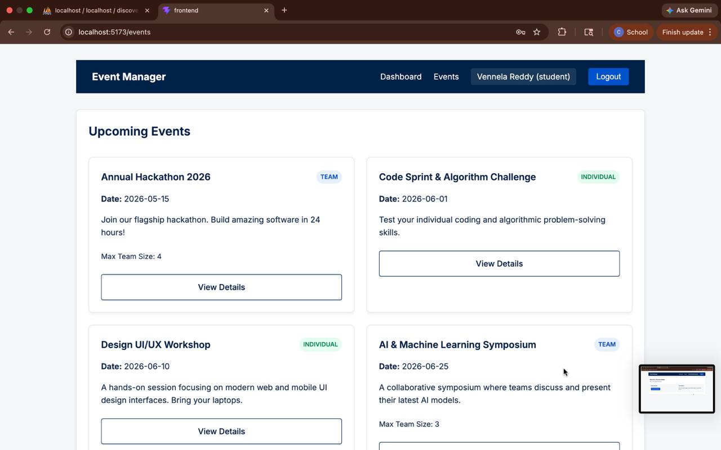
IMPLEMENTATION SCREENSHOTS
Main Module:
The Event Dashboard displays a list of available events in a structured format users can view event details such as title, date, description, and type it allows users to explore and select events based on their interests,The interface is simple and helps in easy event discovery and navigation.
m
1
2
3
4
5
6
7
8(B)
9

Slide 13
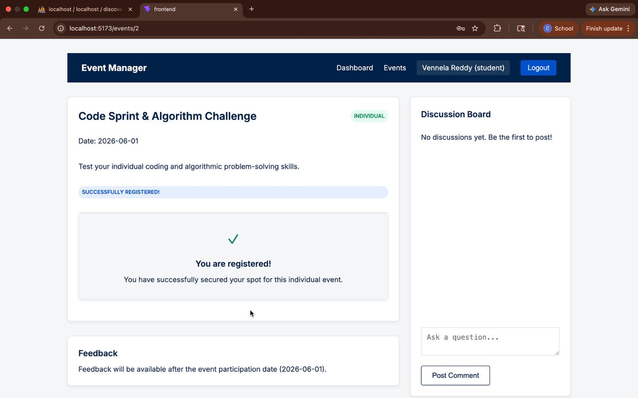
IMPLEMENTATION SCREENSHOTS
Output:
The Registration page allows users to enroll in selected events users can choose individual or team participation and enter required details the system processes the registration and confirms successful enrollment it ensures a simple and smooth event registration experience.
1
2
3
4
5
6
7
8(C)
9

Slide 14
ADVANTAGES & LIMITATIONS
Provides a centralized platform for managing all campus events
Reduces manual work through automation of registration and attendance
Improves accuracy and minimizes human errors
Offers a simple and user-friendly interface for users
Requires internet connectivity for access
Initial setup and maintenance may take time
Limited to campus-level usage unless further enhanced
1
2
3
4
5
6
7
8
9

Slide 15
Thank you

